Slide 1


Simulacrum Test Suite 2.0
Statistical metrics to evaluate Simulacrum output
Edward Pearce
Edward.Pearce@phe.gov.uk

Slide 2
Background
HDI Summer Internship (10 weeks, starting 15th July 2019)
Building on a previous internship project (Paul Clarke, 2017), whose aims were to:
Develop metrics for comparing different Simulacrum versions
Write (SQL) code to automate their calculation

Slide 3
Recap: The Simulacrum
An analytical tool for academic and clinical researchers
“to facilitate research based on the data held in the Cancer Analysis Service (CAS) whilst protecting patient confidentiality.” – HDI
Consists of synthetic datasets generated using a Bayesian Network model
Aims to capture correlations between data fields/features (e.g. How age at diagnosis varies by type of cancer (sites))

Slide 4


An important question
How well does the model represent the real thing?
Notes:
The CAS is a train, and the Simulacrum is a model train
Data is the cargo, with links between datasets (carriages)

Slide 5
How to compare?
The scale of the task:
1,402,817 rows of simulated tumour data
31 different data fields/columns
Some data fields can take 100+ different values
Where to begin?

Slide 6
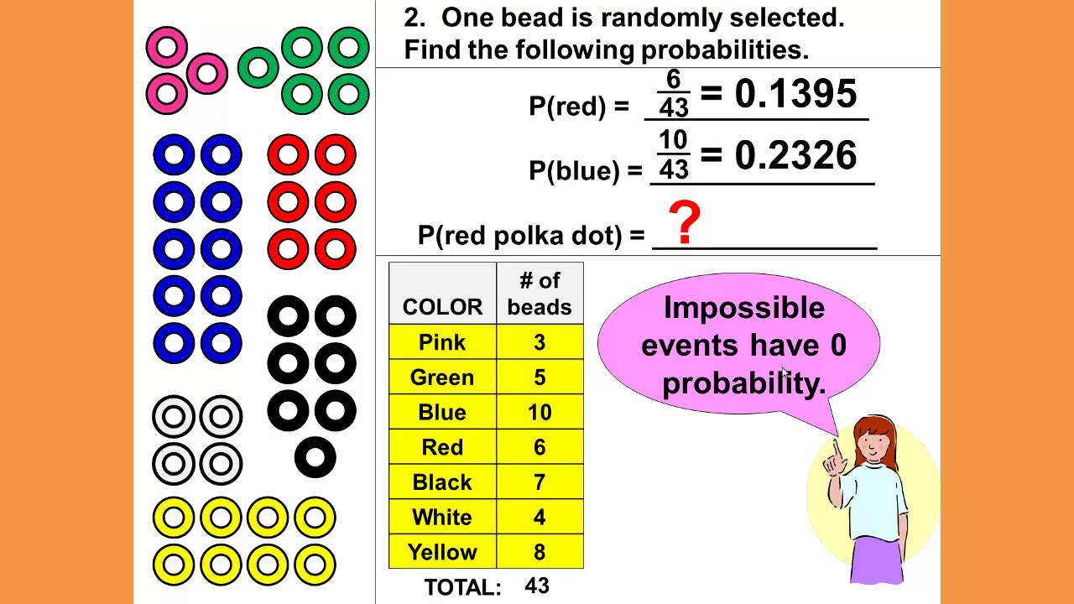
Back to Basics

Slide 7
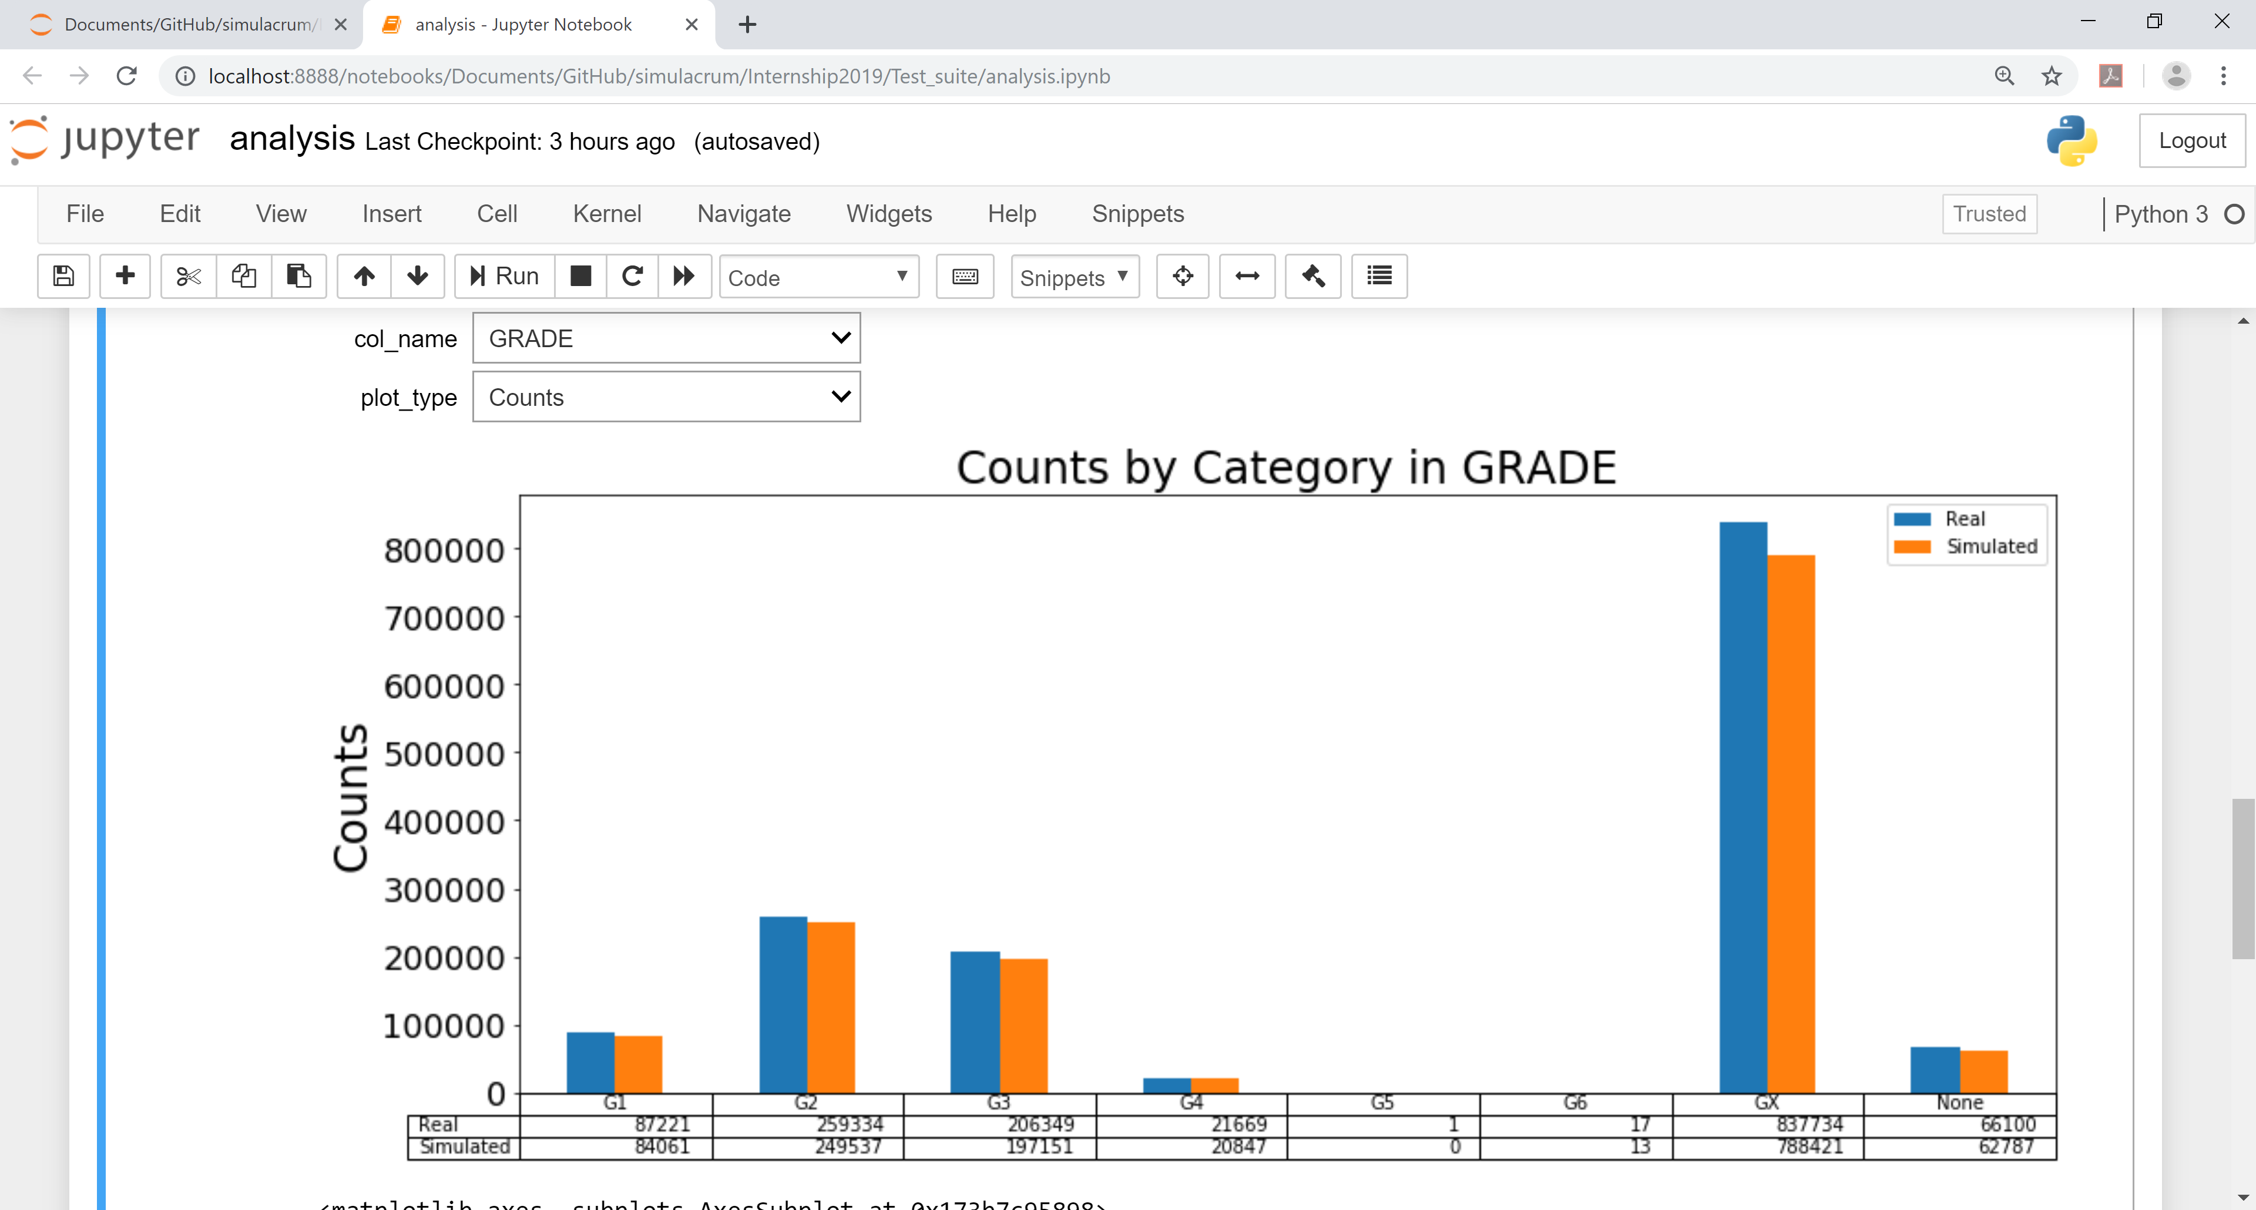

Slide 8
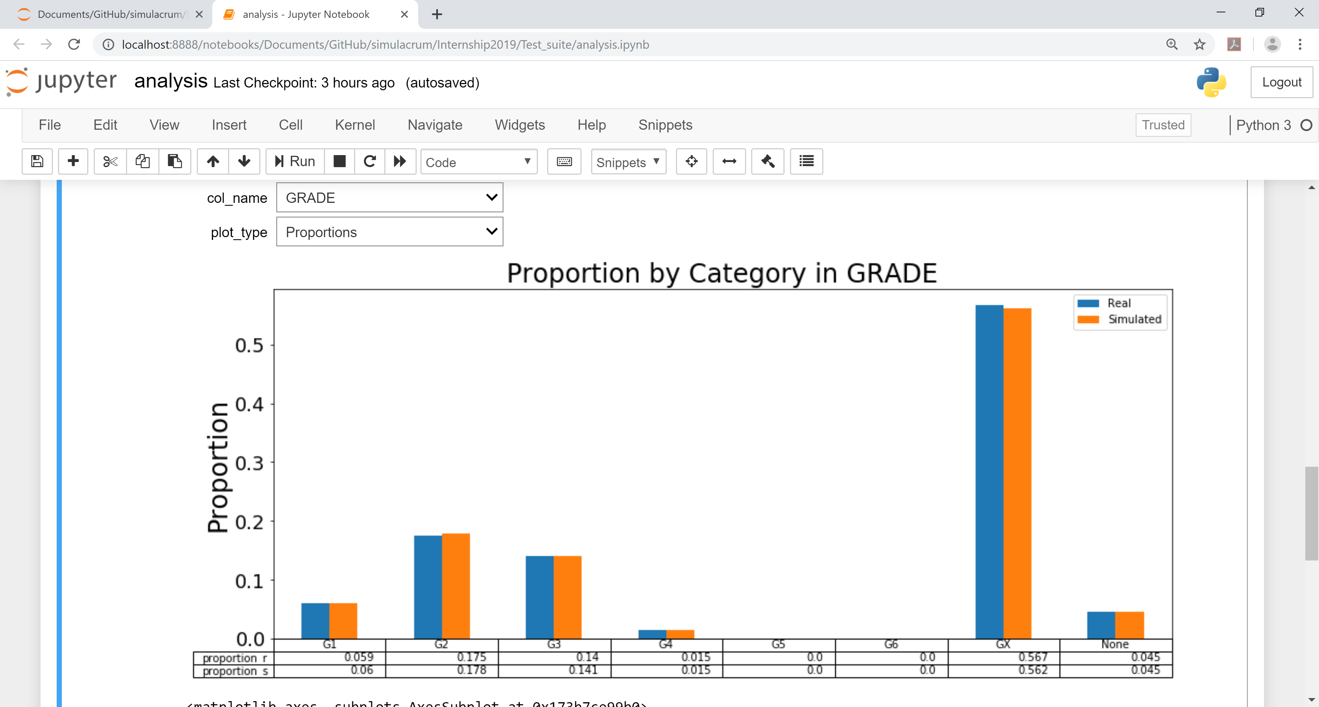

Slide 9
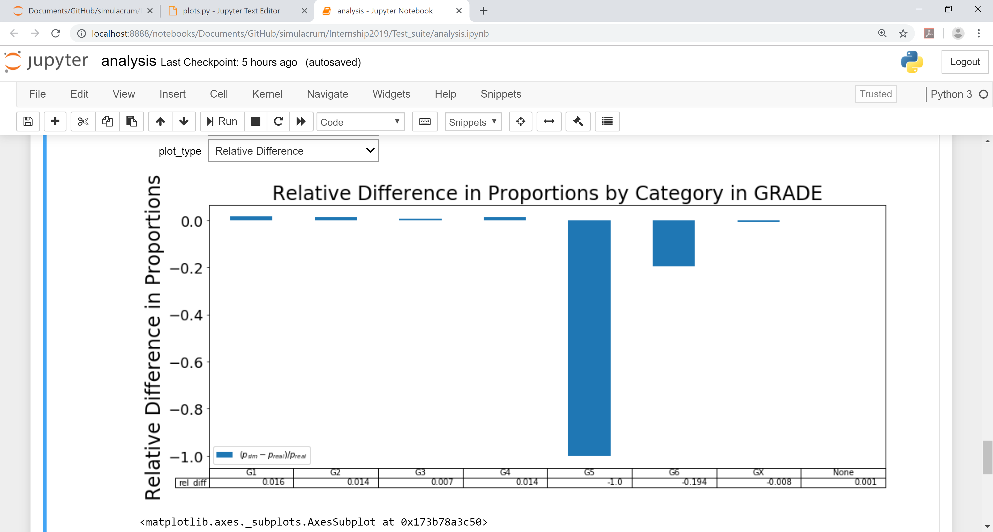

Slide 10
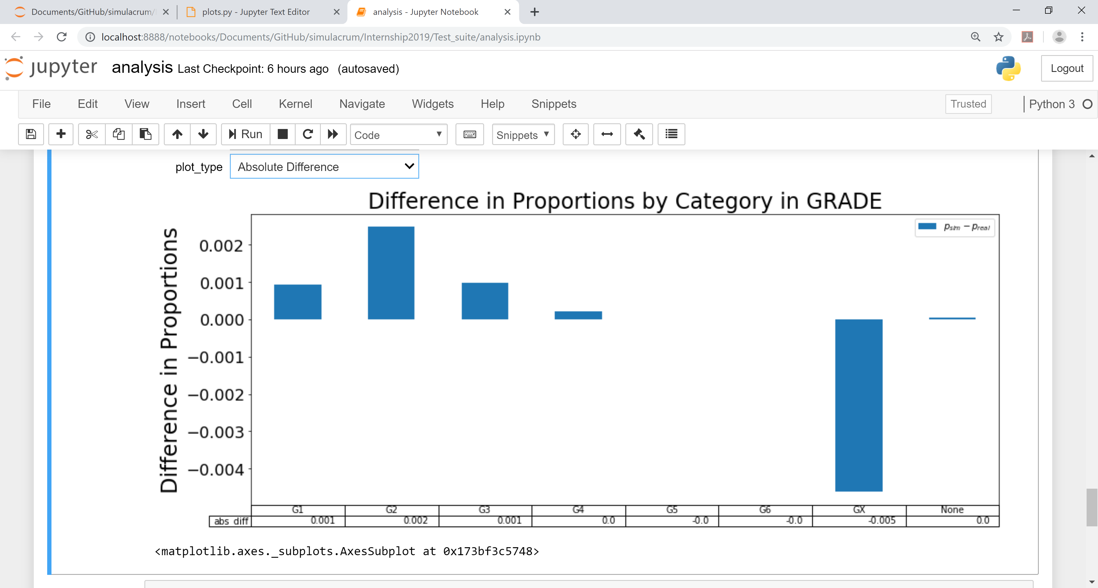

Slide 11
How to compare?
Difference in counts?
Datasets may be of different sizes
Percentage change in proportion?
Can be misleading for small categories
Difference in proportions?
Can be hard to interpret
We need more refined tools to compare the datasets!

Slide 12
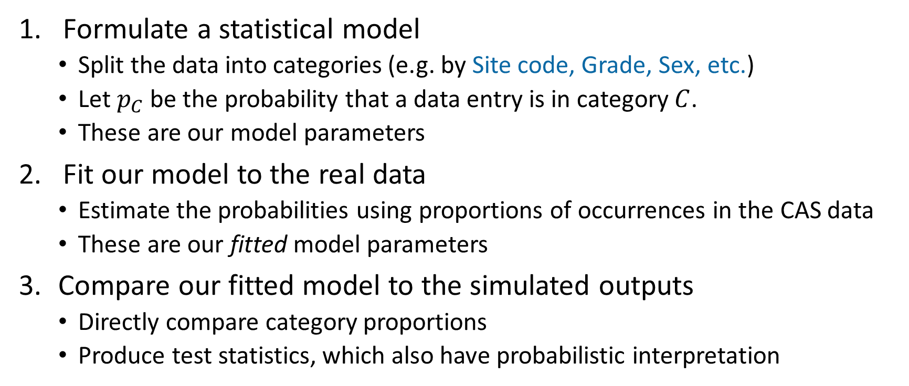
Statistical tests: general formulation
Formulate a statistical model
Split the data into categories (e.g. by Site code, Grade, Sex, etc.)
Let $p_{C}$ be the probability that a data entry is in category $C$.
These are our model parameters
Fit our model to the real data
Estimate the probabilities using proportions of occurrences in the CAS data
These are our fitted model parameters
Compare our fitted model to the simulated outputs
Directly compare category proportions
Produce test statistics, which also have probabilistic interpretation
Notes:
If the real data was produced according to our fitted model, how likely is it that the simulated data was also produced from this fitted model?

Slide 13
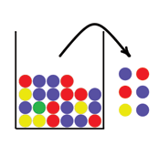
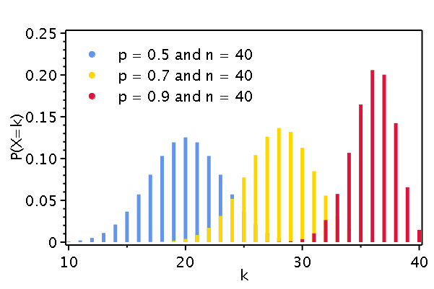
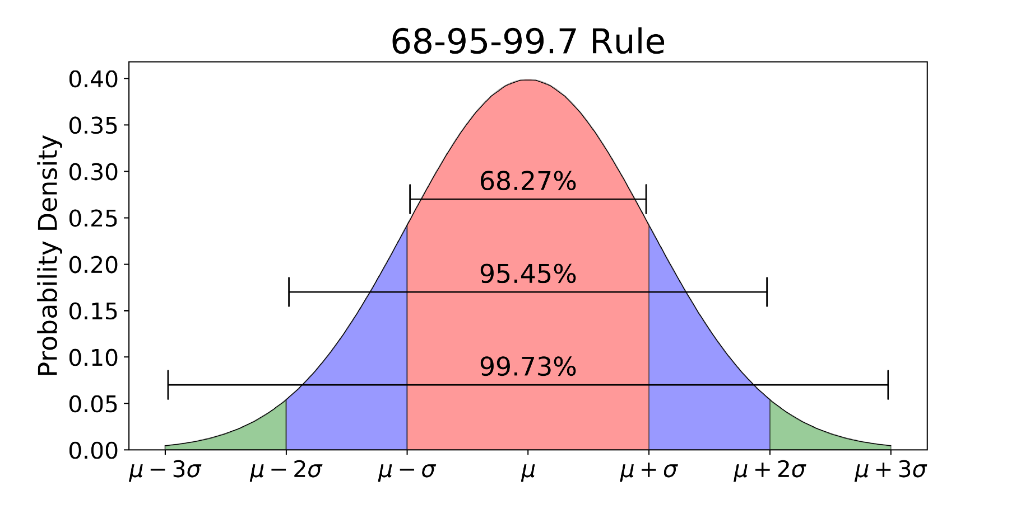
One-sample z-test with Binomial assumption
Statistical assumptions
Values sampled with replacement from real population
Binomially distributed
Normal approximation valid
Notes:
1. Assume that data values were sampled randomly, with replacement, from the values occurring in the real population
2. Model the value counts by binomial distributions with probability parameters equal to their proportions in the real population
3. Our discrete Binomial distribution(s) are not skewed, so can be approximated by a continuous Normal distribution

Slide 14
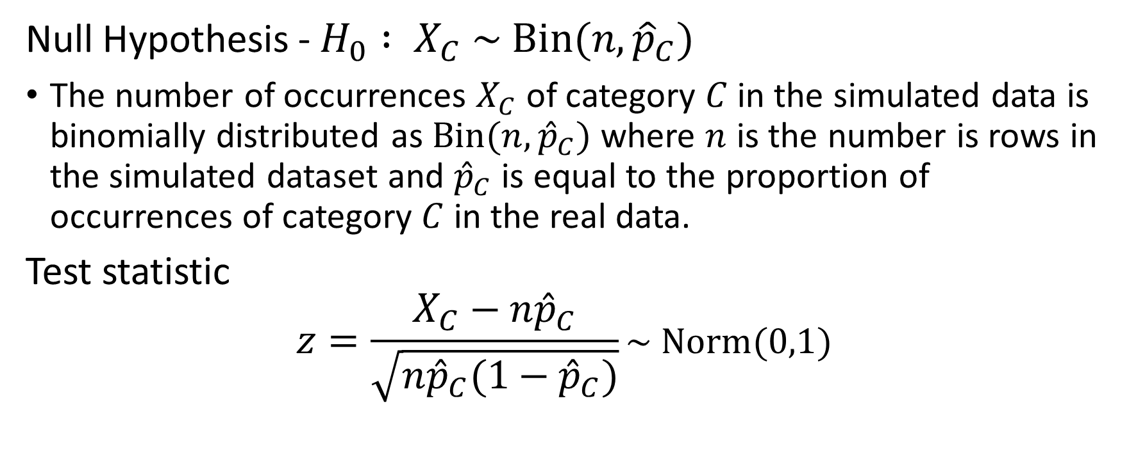
One-sample z-test with Binomial assumption
Null Hypothesis - $H_{0} : X_{C} \sim Bin(n,{\hat{p}}_{C})$
The number of occurrences $X_{C}$of category $C$ in the simulated data is binomially distributed as $Bin(n,{\hat{p}}_{C})$ where $n$ is the number is rows in the simulated dataset and ${\hat{p}}_{C}$is equal to the proportion of occurrences of category $C$ in the real data.
Test statistic
$$z=\frac{X_{C}−n{\hat{p}}_{C}}{\sqrt{n{\hat{p}}_{C}(1−{\hat{p}}_{C})}}\sim Norm(0,1)$$

Slide 15
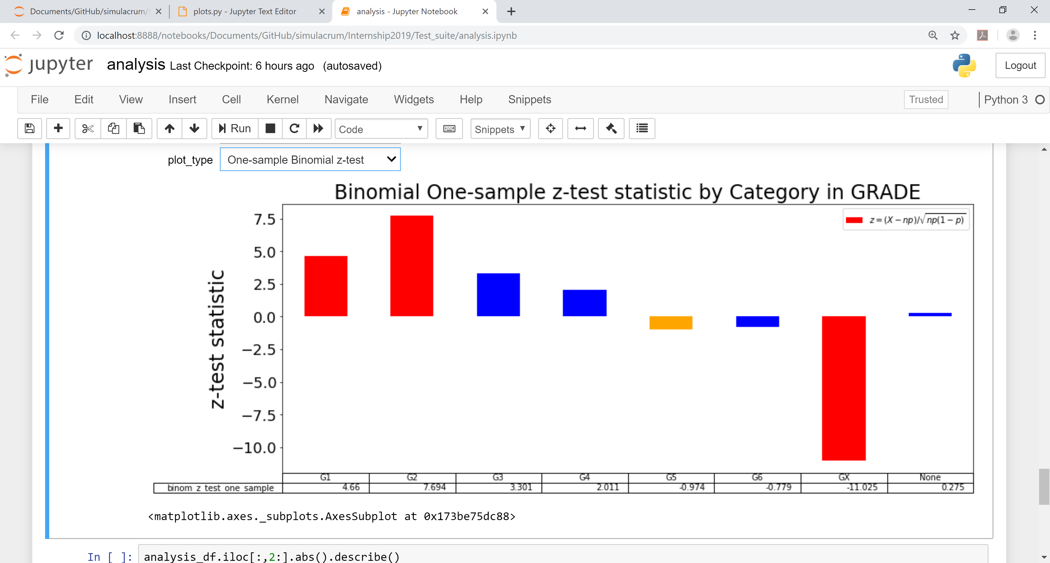

Slide 16
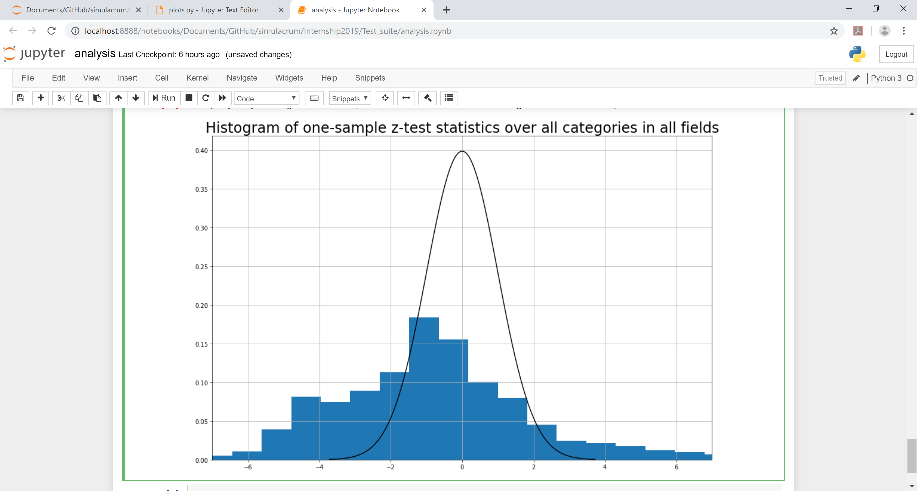
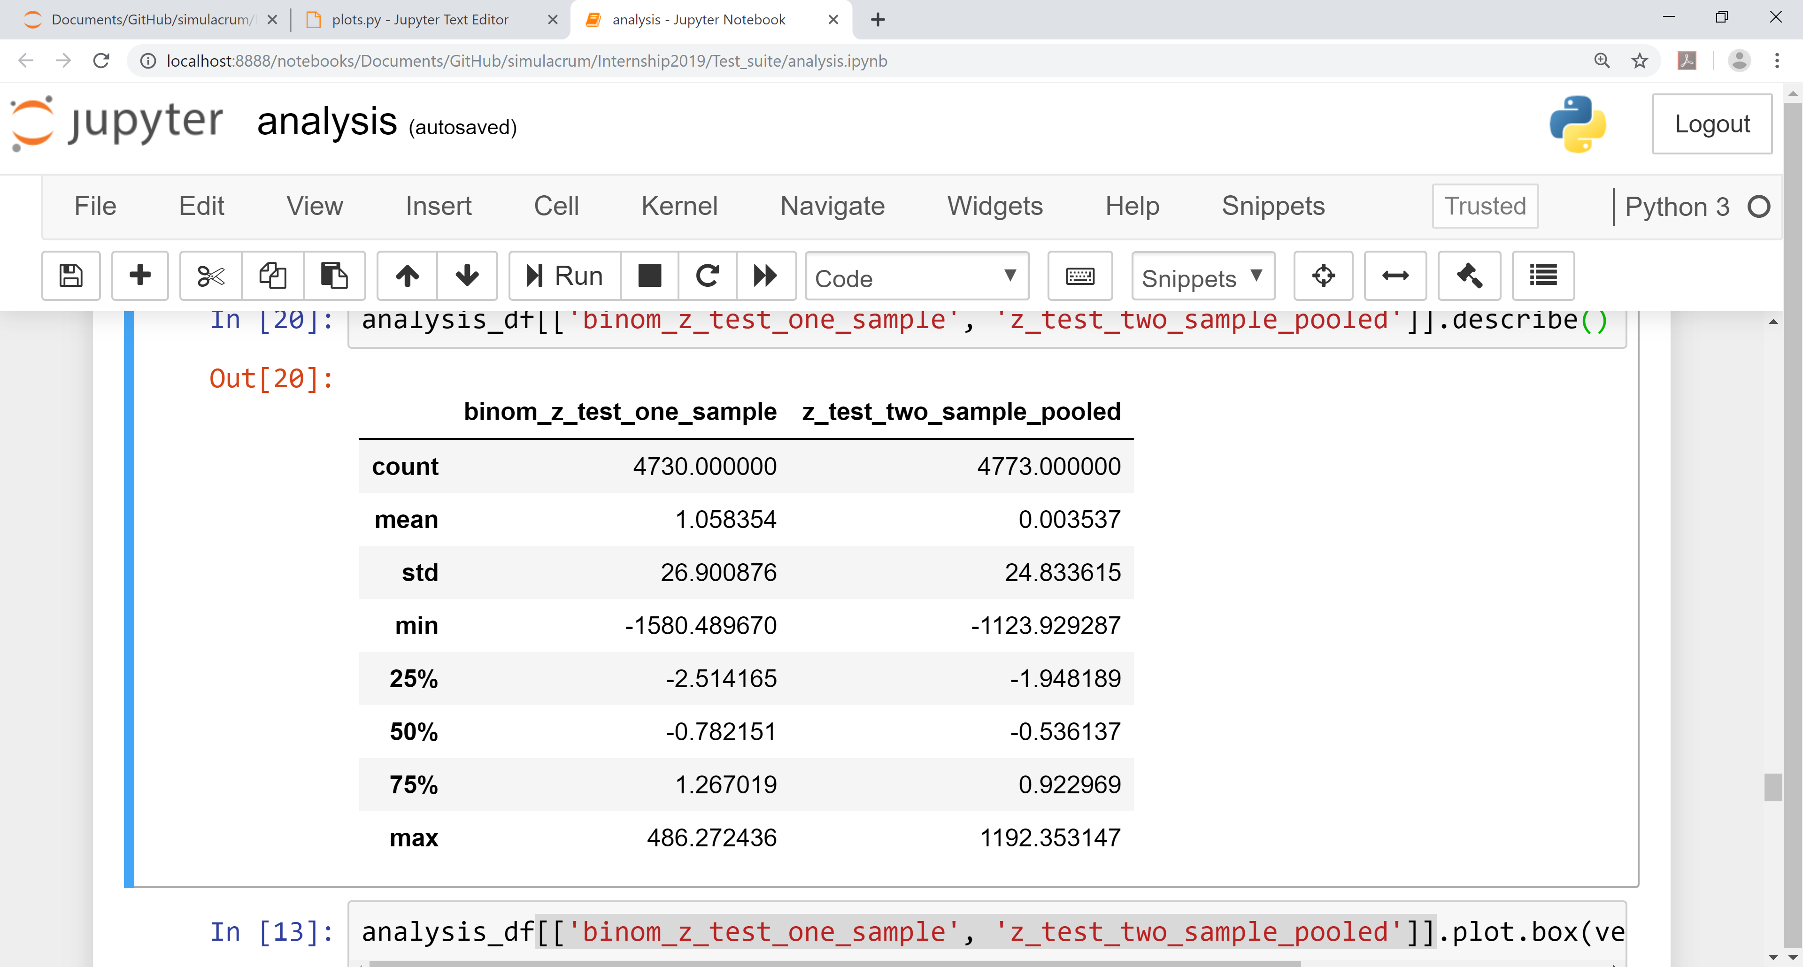

Slide 17
One-sample z-test with Binomial assumption
Statistical assumptions
Values sampled with replacement from real population
Binomially distributed
Normal approximation valid
Notes:
1. Assume that data values were sampled randomly, with replacement, from the values occurring in the real population
2. Model the value counts by binomial distributions with probability parameters equal to their proportions in the real population
3. Our discrete Binomial distribution(s) are not skewed, so can be approximated by a continuous Normal distribution

Slide 18

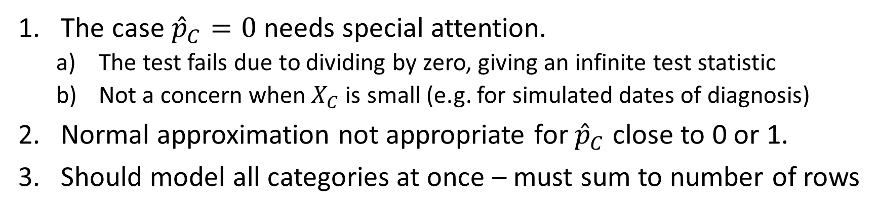
One-sample z-test: Limitations
The case ${\hat{p}}_{C}=0$ needs special attention.
The test fails due to dividing by zero, giving an infinite test statistic
Not a concern when $X_{C}$is small (e.g. for simulated dates of diagnosis)
Normal approximation not appropriate for ${\hat{p}}_{C}$ close to 0 or 1.
Should model all categories at once – must sum to number of rows

Slide 19
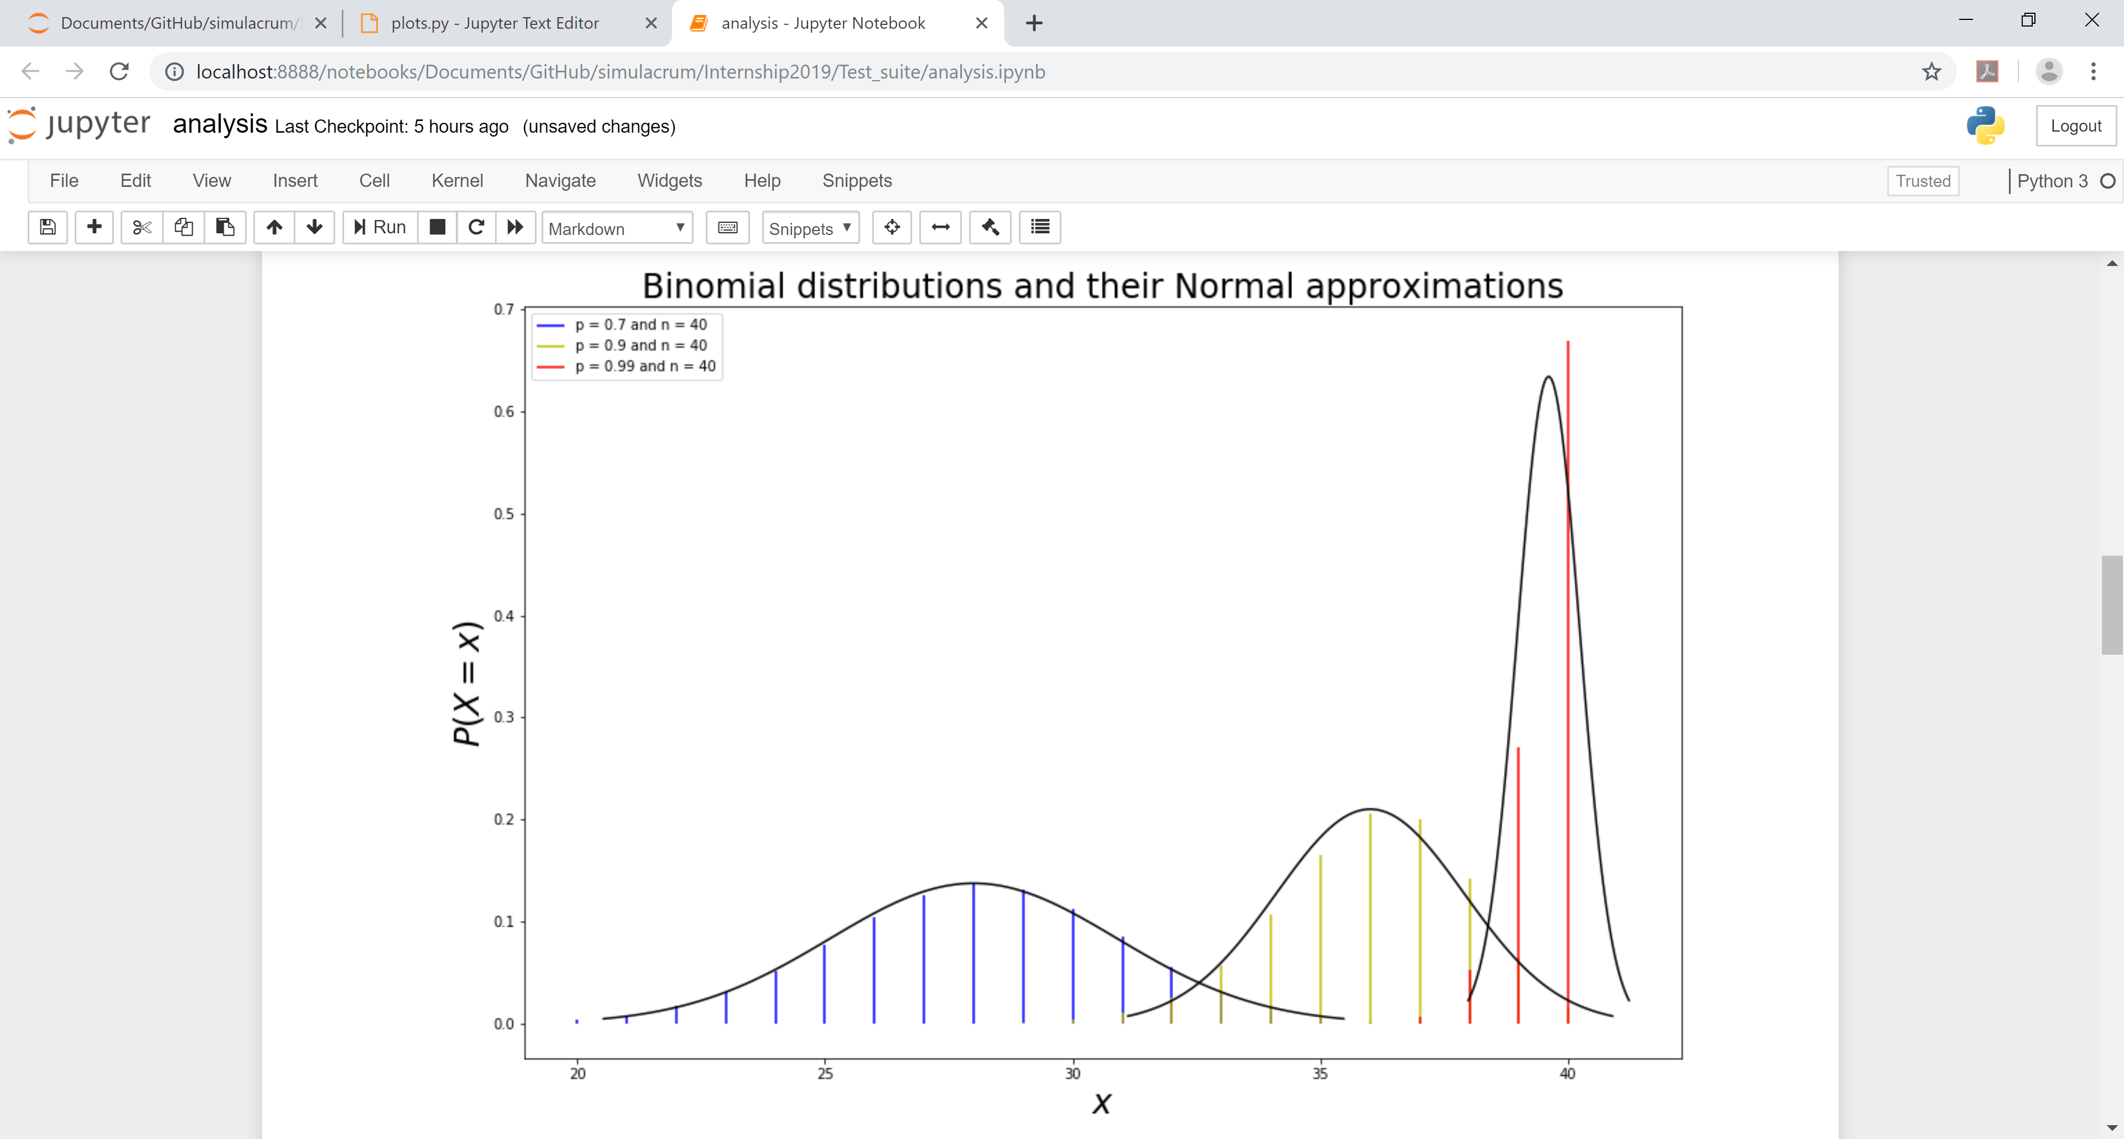

Slide 20
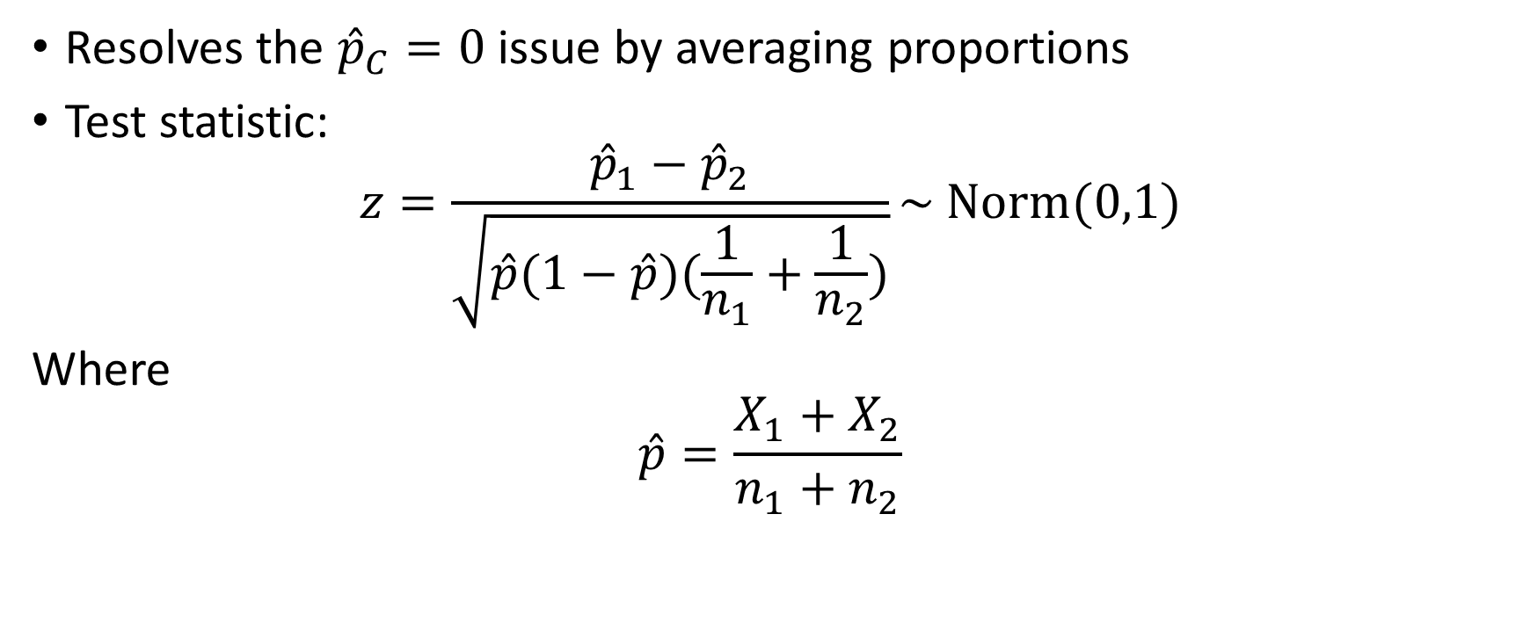
Pooled Two-sample z-test
Resolves the ${\hat{p}}_{C}=0$ issue by averaging proportions
Test statistic:
$$z=\frac{{\hat{p}}_{1}−{\hat{p}}_{2}}{\sqrt{\hat{p}(1−\hat{p})(\frac{1}{n_{1}}+\frac{1}{n_{2}})}}\sim Norm(0,1)$$
Where
$$\hat{p}=\frac{X_{1}+X_{2}}{n_{1}+n_{2}}$$

Slide 22
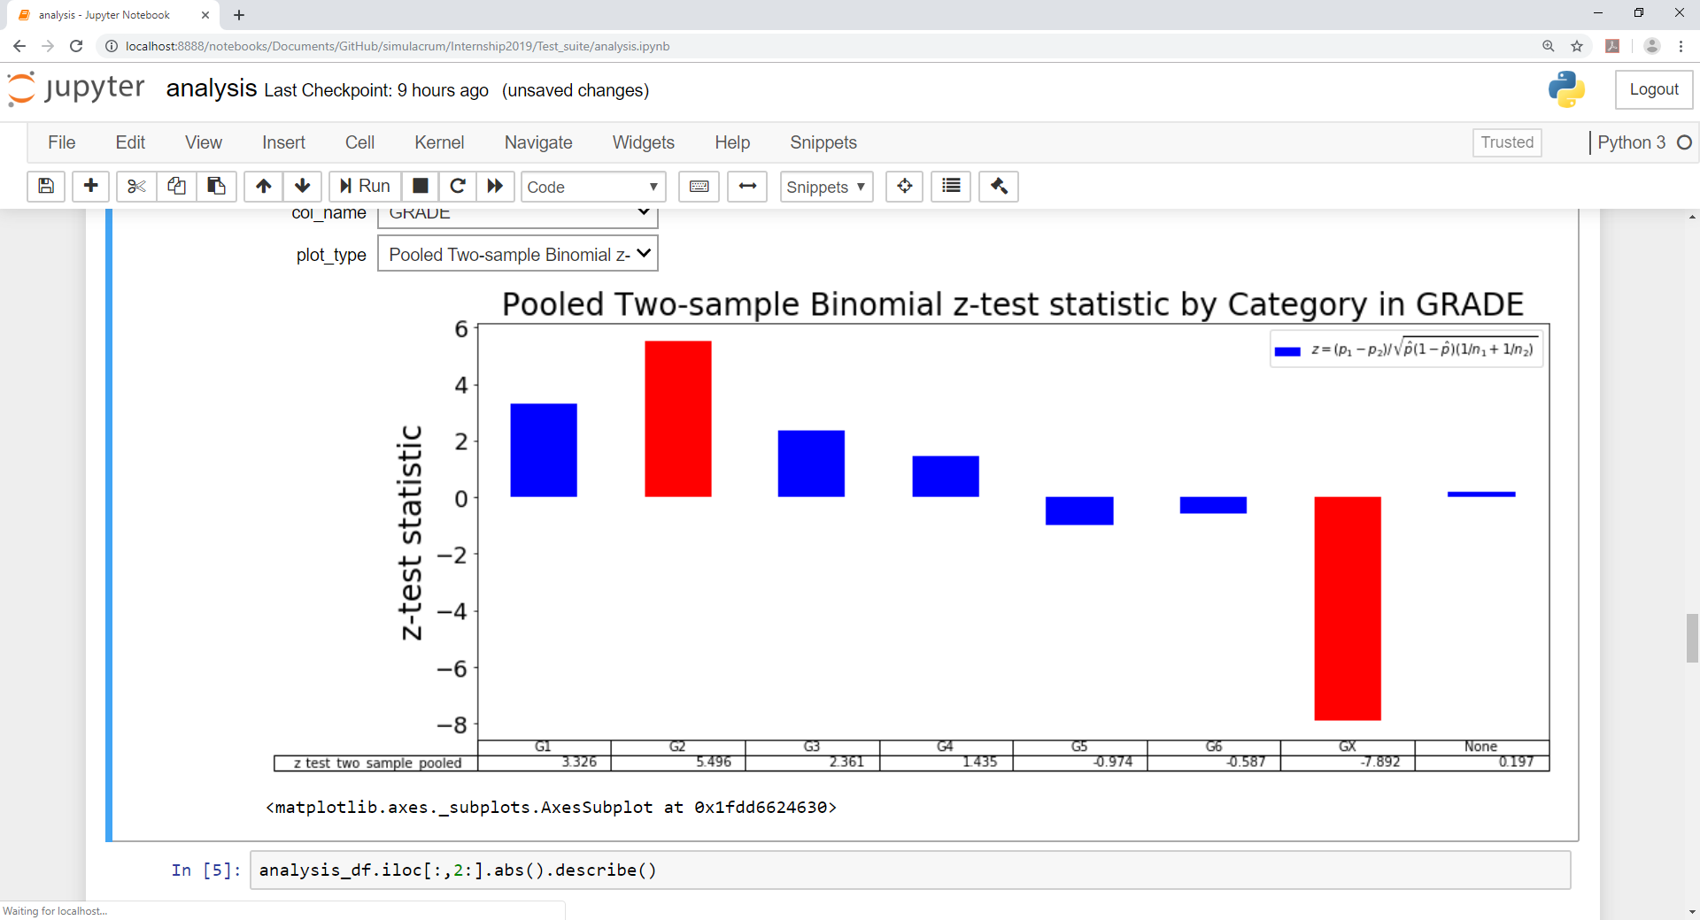

Slide 23
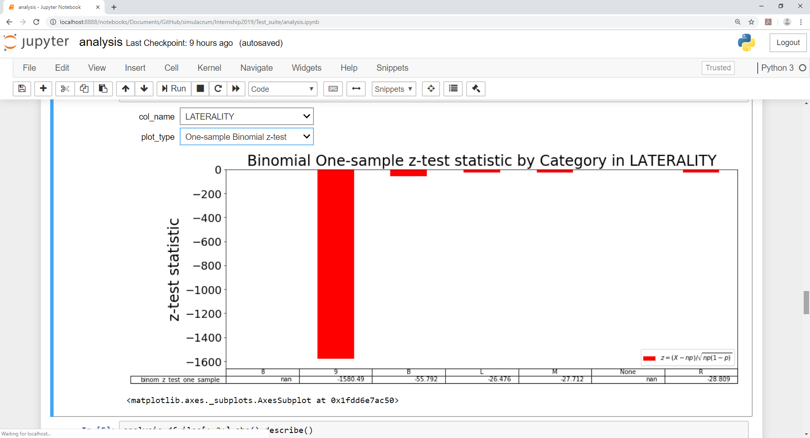

Slide 24
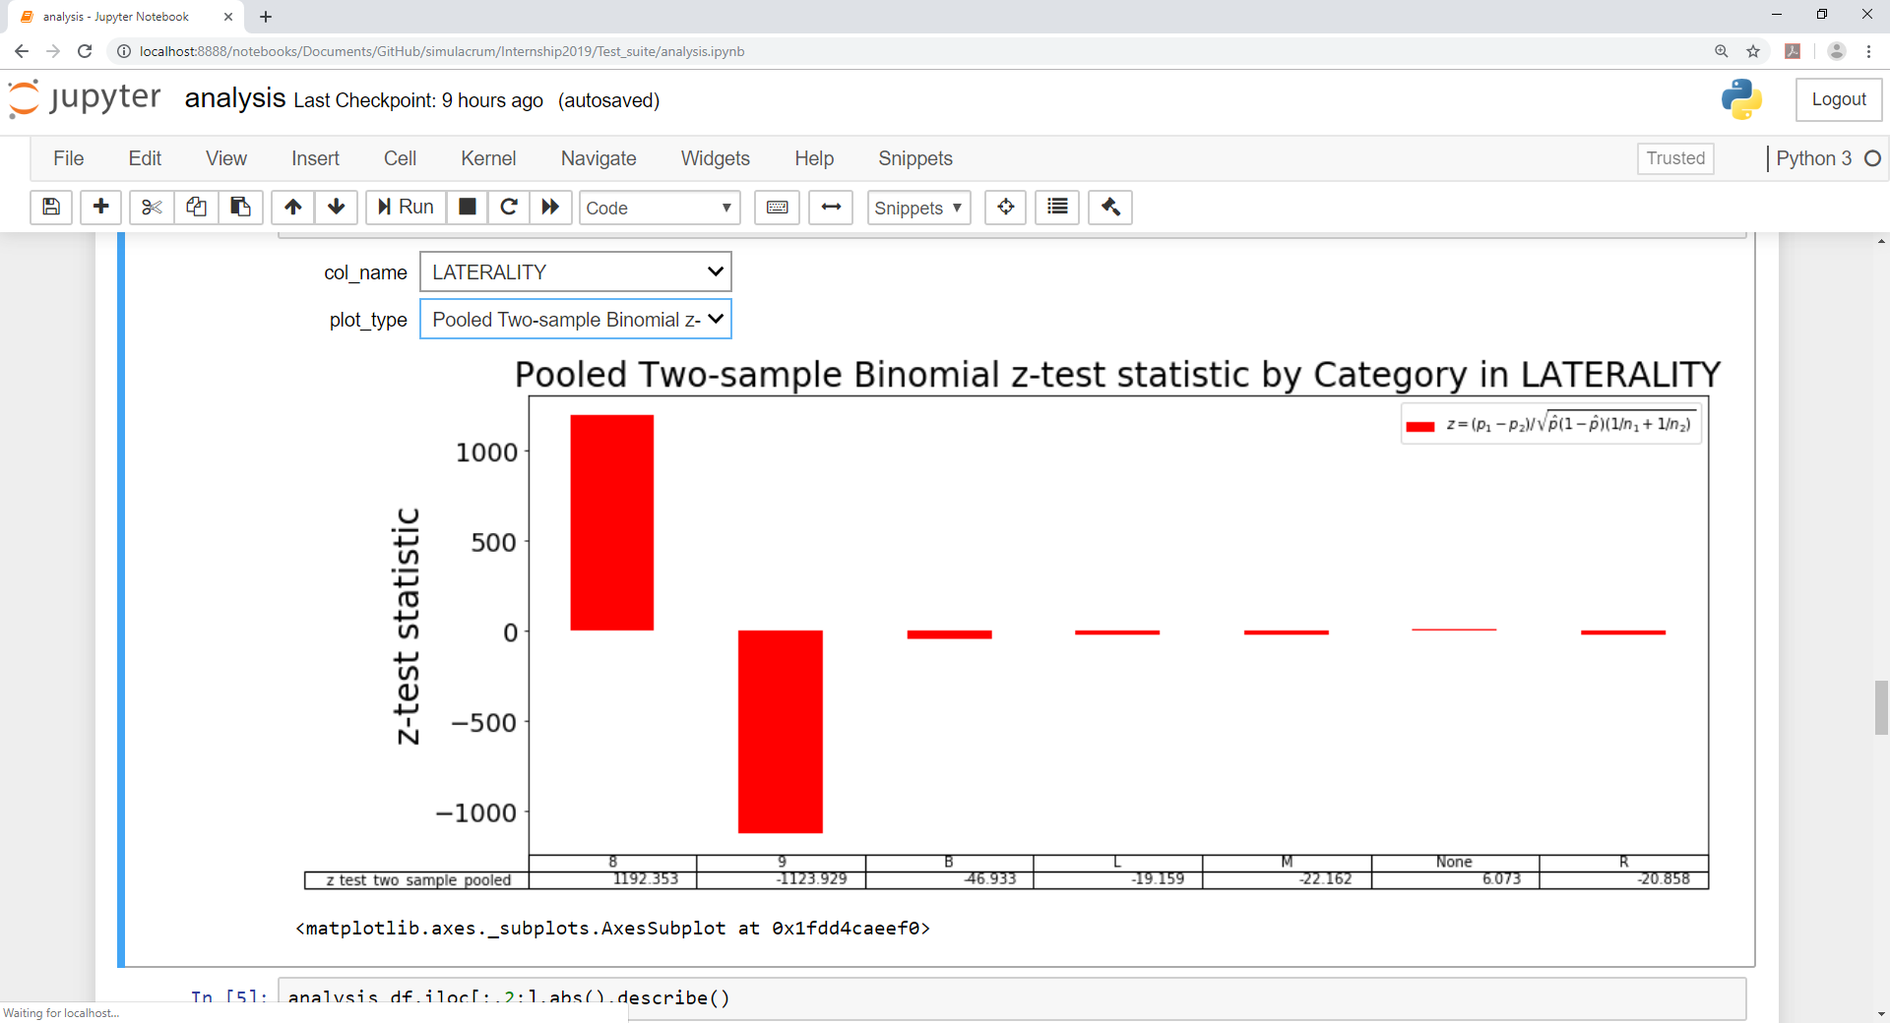

Slide 26
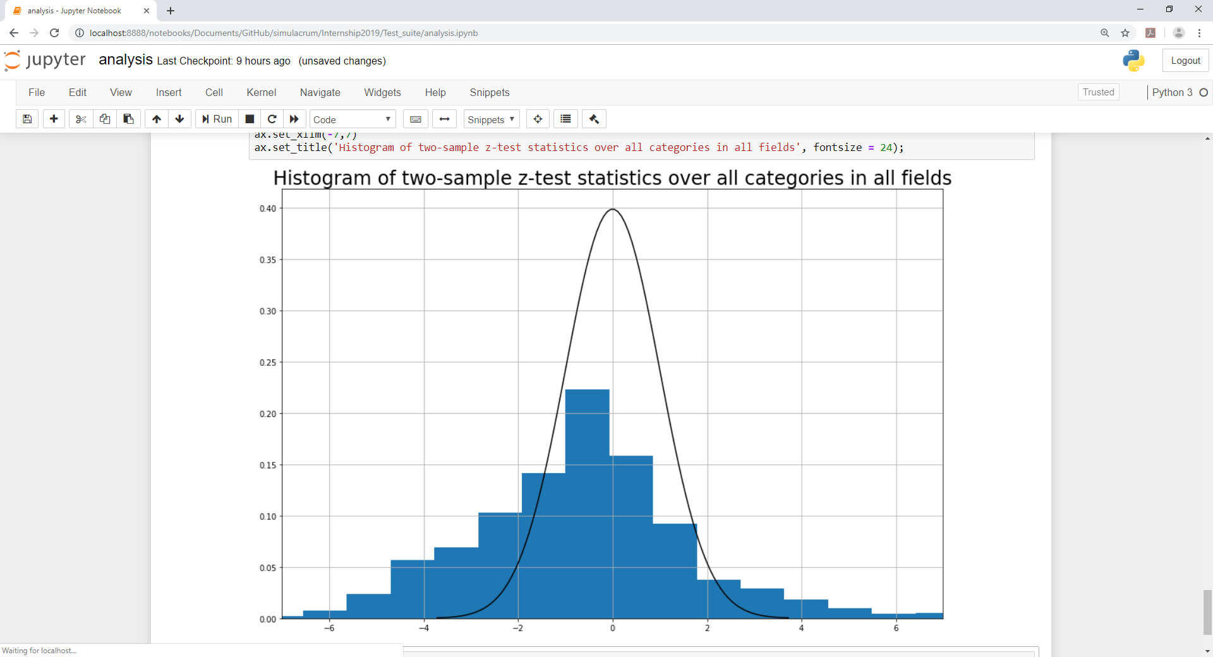
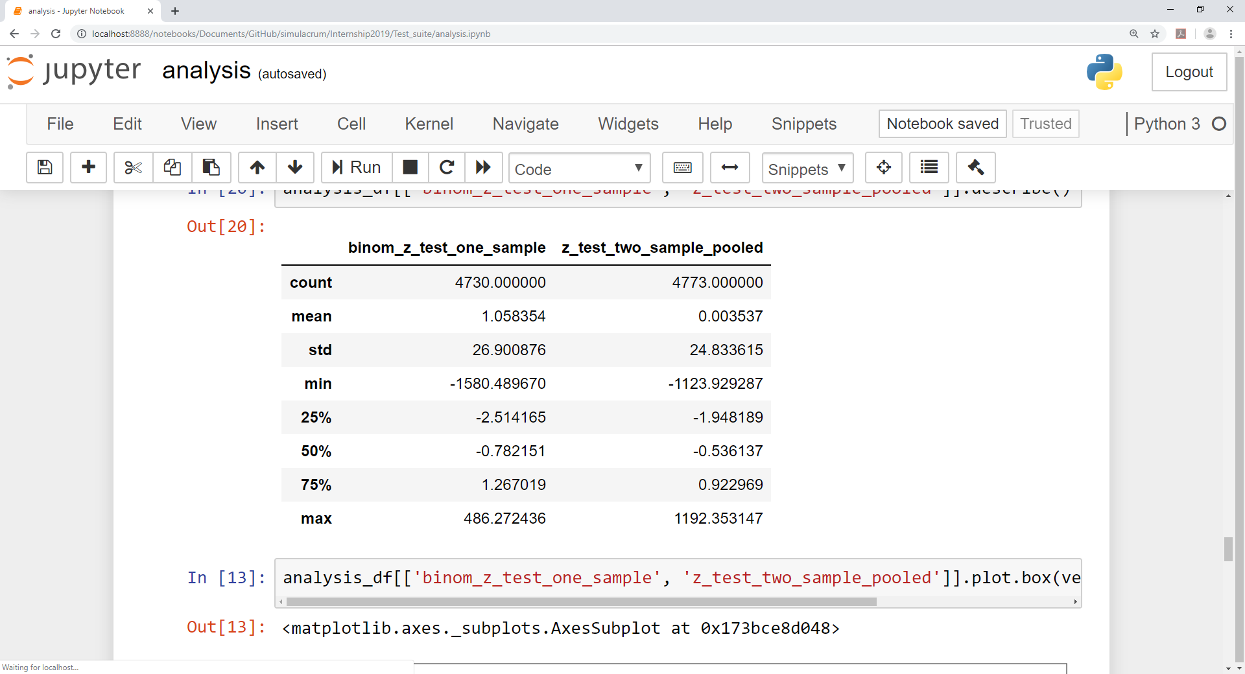

Slide 27
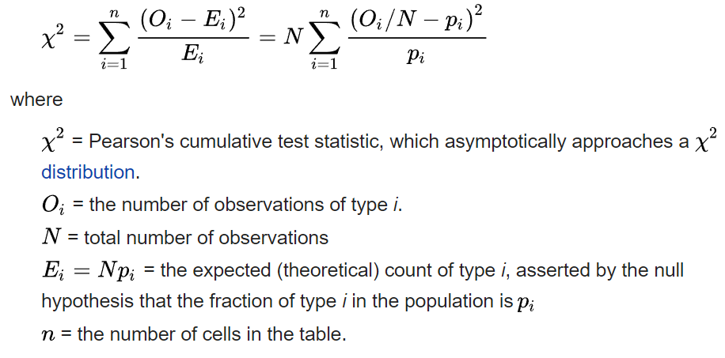
Pearson’s Chi-squared test
Models all of the categories in a data field at once
Test statistic:

Slide 28
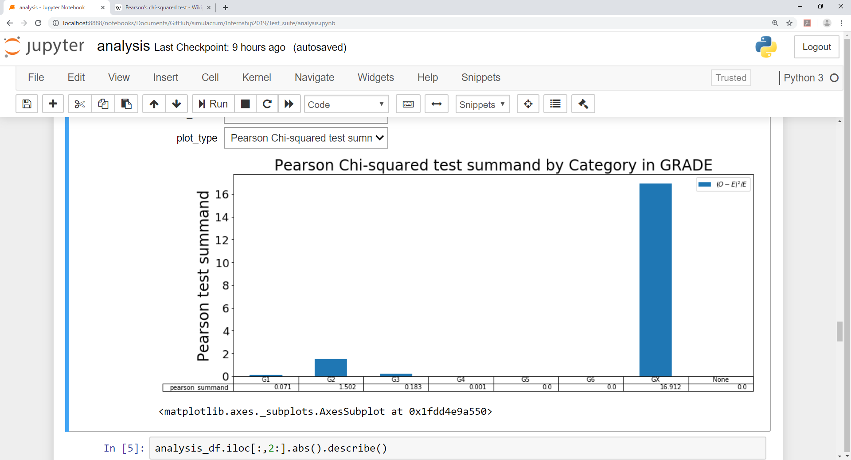

Slide 29
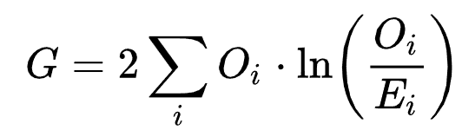
Likelihood-ratio test
Models all of the categories in a data field at once
Test statistic:
Also to be compared against a chi-squared distribution

Slide 30
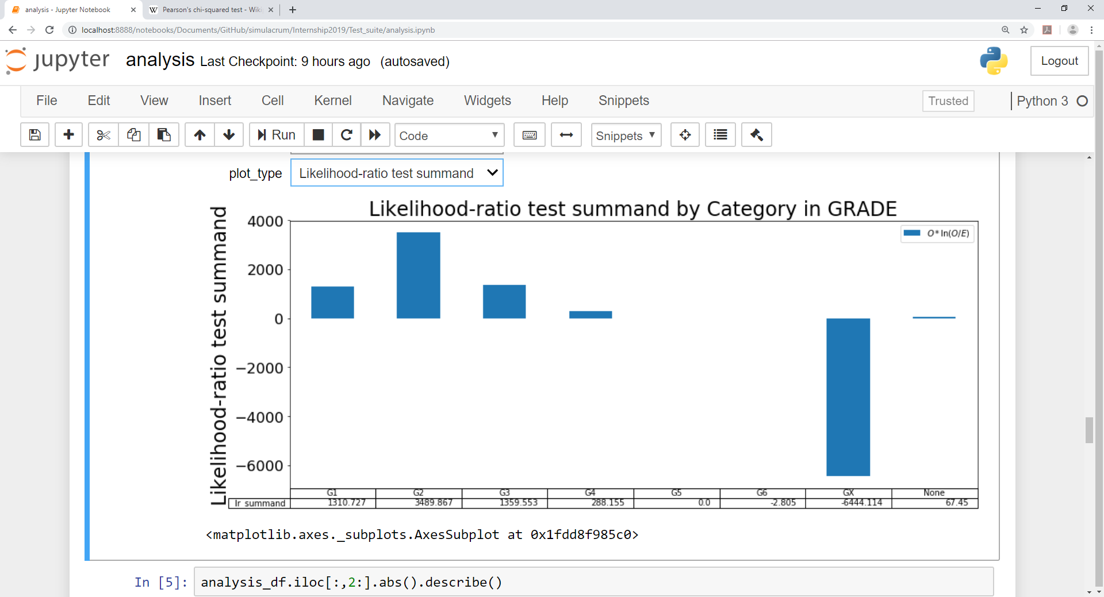

Slide 31
Conclusion
Several comparison methods
Can identify unexpected behavior/poorly simulated fields
Produced an app to easily create and view plots of the different test-statistics and comparison results
No coding/copying and pasting required!
Compare performance using a range of test statistics
Visualizations as well as tabulated results

Slide 32
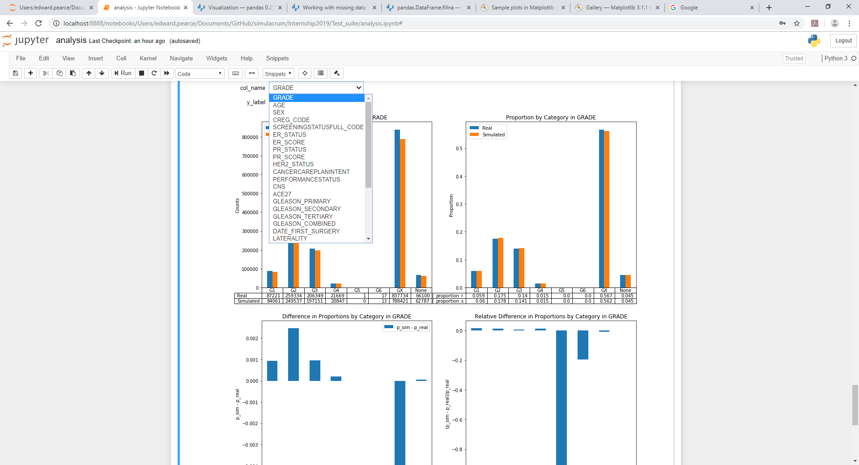
Interactive demo

Slide 33
Future directions
Bespoke tests for continuous data types (Age, Dates)
Testing combinations of co-dependent variables
Improving user interface and visualizations
Choose a pair of datasets to compare
Compare multiple tables at once

Slide 34
Other work
Collaborative project with SACT team at Wellington House in London (Bukky Juwa, Alice Turnbull)
Background: SACT team produces routine activity reports (limited release, within PHE/NHS only) on SACT datasets
Goal: to produce analogous data visualization reports on the simulated SACT datasets
Simulated SACT reports would be suitable for publication, as well as for comparison with the real SACT reports

Slide 35
Thanks for listening!
Any questions?
Contact email: Edward.Pearce@phe.gov.uk

